Slide 1

Project Overview
By
Badam Sandeep Gupta
Data Analyst Intern

Slide 2
Table of Contents
Project 1 – FDI Analysis
Introduction
Problem Statement
Objective
Methodology
Insights
KPIs & Dashboard
Findings
Conclusion
Project 2 – Attrition Data Analysis
Introduction
Problem Statement
Objective
Methodology
Insights
KPIs & Dashboard
Findings
Conclusion

Slide 3
Project – 1 Foreign direct investment analysis

Slide 4

What is FDI ?
The term foreign direct investment (FDI) refers to an ownership stake in a foreign company or project made by an investor, company, or government from another country. FDI is generally used to describe a business decision to acquire a substantial stake in a foreign business or to buy it outright to expand operations to a new region. The term is usually not used to describe a stock investment in a foreign company alone. FDI is a key element in international economic integration because it creates stable and long-lasting links between economies.

Slide 5
Problem Statement
Investment is a game of understanding historic data of investment objects under different events but it is still a game of chances to minimize the risk we apply analytics to find the equilibrium investment.
To understand the Foreign direct investment in India for the last 17 years from 2000-01 to 2016-17. This dataset contains sector and financial year-wise data of FDI in India Sector-wise investment analysis Year-wise investment analysis.
Find key metrics and factors and show the meaningful relationships between attributes. Do your own research and come up with your finding

Slide 6
Objective
Understand the Trends:
Examine yearly trends in FDI to identify periods of significant growth or decline.
Determine how investments have evolved over time and identify any patterns or anomalies.
Sector-Wise Analysis:
Analyse FDI distribution across different sectors to identify which sectors have attracted the most investment.
Understand the sectoral preferences of foreign investors and highlight key sectors driving FDI.
Identify Key Metrics:
Calculate and interpret key metrics such as total investments, yearly growth rates, and sector-wise contributions.
Identify meaningful relationships between different attributes in the dataset.
Business Problems and Solutions:
Address business problems such as diversification of investments across sectors and identification

Slide 7
Project Workflow
Data Exploration and Cleaning
Tableau Dashboard Creation
Data Analysis
Visualization & Insights
Data Storytelling & Recommendations

Slide 8
Details of dataset and Methodology
Details of Dataset:
The dataset consist of financial years from 2000-2016 and also have different sectors.
The investment of foreign investors in the sectors of India is in terms of million USD.
Methodology:
Import Data in tableau
Unpivoting data from converting wide format to long format
Cleaning Labels

Slide 9
Case study
Trend of overall foreign direct investment
Top 10 sectors with maximum FDI
Top 10 sectors with minimum FDI
Sectors that reported high growth in FDI in last 5 years
Sectors that reported high decline in FDI in last 5 years
Which sectors has most variation in FDIs
Is there any correlation between these sectors from FDI perspective
Forecast

Slide 10
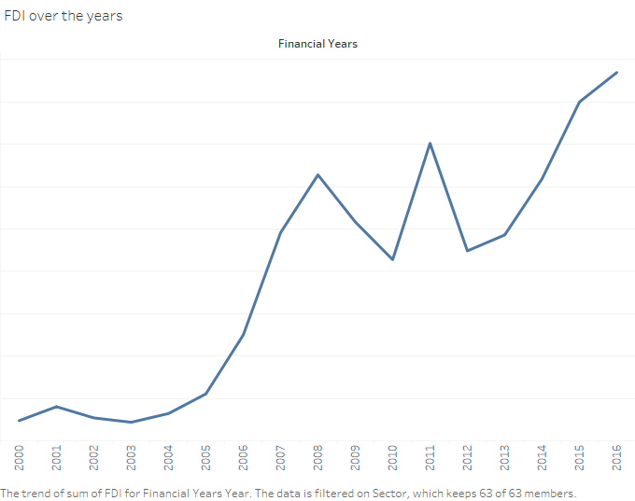
Trend of Overall FDI

Slide 11
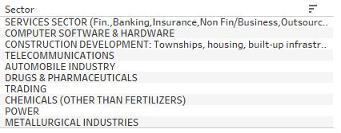
Top 10 Sectors with max FDI

Slide 12
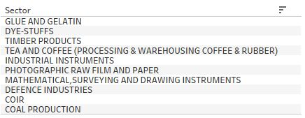
Top 10 Sectors with min FDI

Slide 13
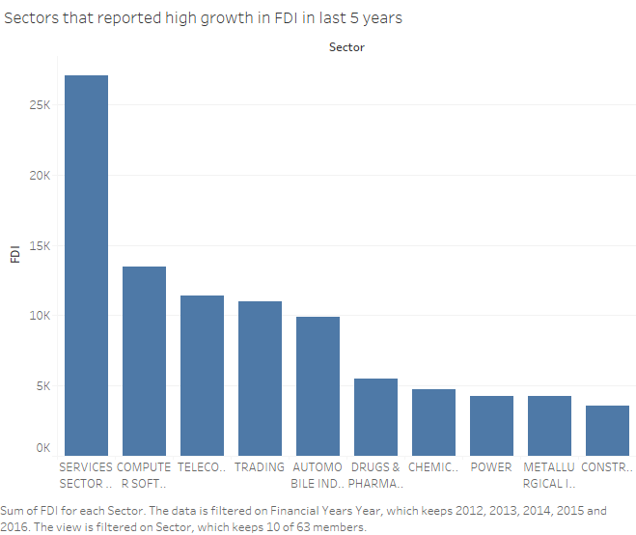
Sectors with high growth in FDI in last 5 years

Slide 14
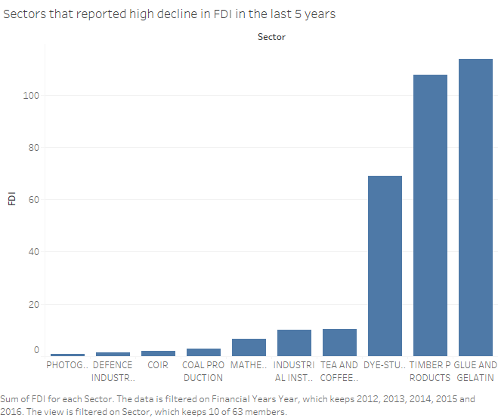
Sectors with Low growth on FDI in Last 5 Years

Slide 15
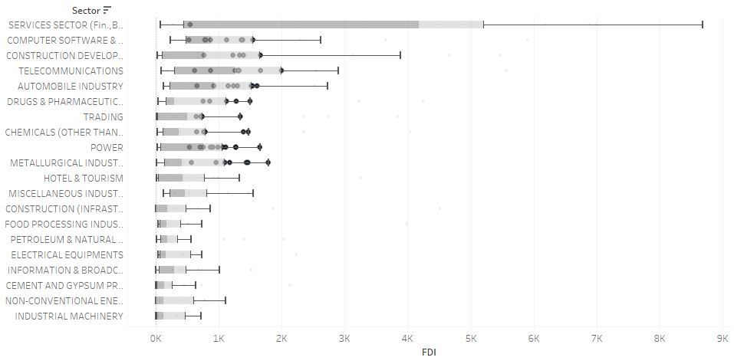
Sectors having most Variations

Slide 16
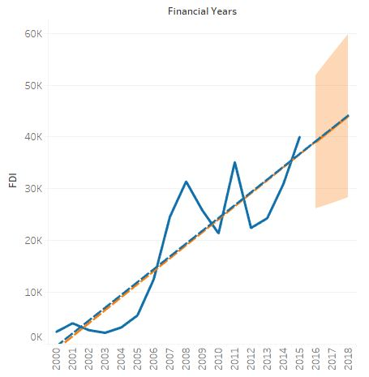
Forecast

Slide 17
Findings
The proportion of FDI in Service sector is the highest among different sectors.
Finally, I observed that linear trend fits well with the distribution of the data as it was showing a positive trend. The actual forecast indicator R value is 0.79 and the estimated forecast indicator R value is 1, which shows it is close to 1 of the estimated forecast indicator.
The P - value is less than 0.0001 for both estimated and actual forecast which shows that the model indicates the statistical significance.
So, according to forecasting trend-line, the model predicted the values for 2016, 2017 and 2018 financial years.
For 2016, 2017 and 2018 it is estimated to be 39009, 41517 and 44025 million USD

Slide 18
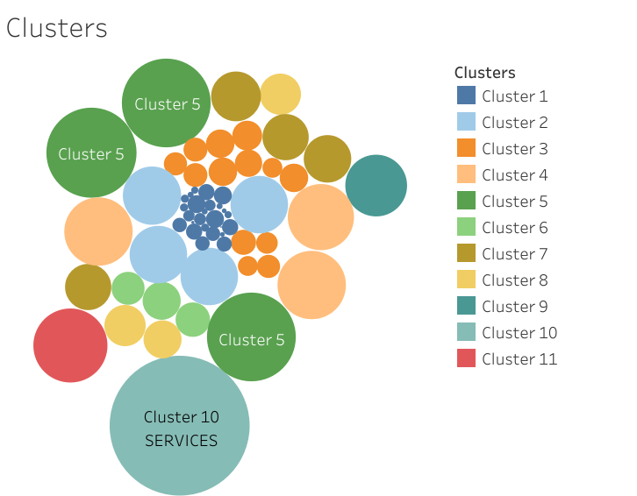
Clusters for different sectors

Slide 19
Clusters
The clusters shows the grouping of different sectors having same range of FDI, which showcase the linear relationship between different features such as
Cluster 1 includes sectors with FDI less than 2k million USD.
Cluster 2 includes sectors (Metallurgical Industries, Miscellaneous Industries, Hotel & Tourism and Construction (Infrastructure) activities.
Cluster 5 includes sectors (Computer Software and Hardware, Telecommunications and Construction development) with FDI having the investment within the range of 23k -24k million USD.

Slide 20
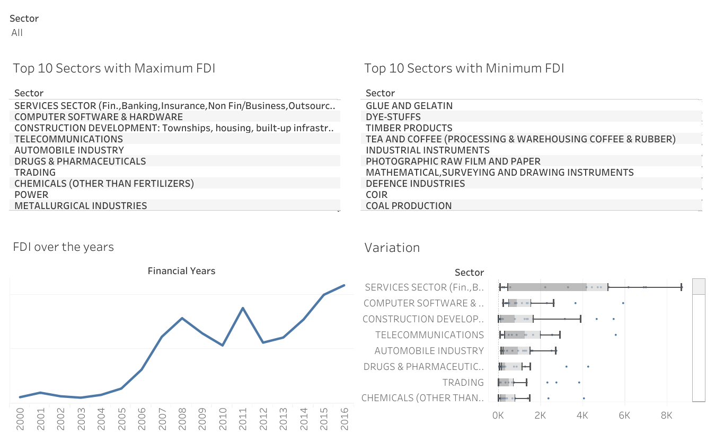
Dashboard-1

Slide 21
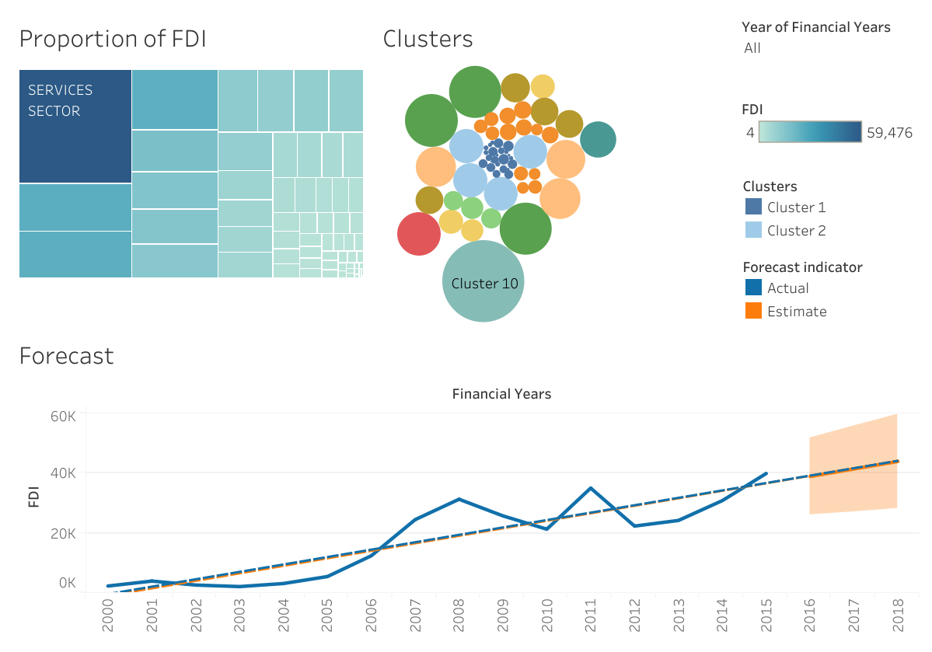
Dashboard-2

Slide 22
Findings
In case of sectors with maximum FDI, the service sector ranks the highest followed by the computer software and hardware and in case of sectors with minimum FDI, the coal production ranks the lowest.
In case of sectors with high FDI in last 5 years (2012-2016), the service sector still have the top spot.
In case of sectors with low FDI in last 5 years (2012-2016), photographic raw film and paper have the lowest spot.
The FDI over the years from 2000 to 2016 shows a positive trend even though there is a drop in 2010 and 2012.
The FDI is increasing since 2012.
The Service sector, followed by computer software and hardware, and construction development, has the most variations.

Slide 23
Insights
From the Tableau dashboard observations and jupyter notebook bar graphs we can observe that every financial year all sectors are trying to invest its best.
As some sectors are investing high amount and some sectors investing low amount and some sectors are having zero investment during the financial years.
The Services sector(E.g. Banking & Insurance, etc.)and Computer Software& Hardware Components &Some sectors are trying to invest more amount than remaining sectors.
Some Sectors are Investing Every Financial Year like the trend changes but investing in every Financial Year.
In the upcoming slides we will mention Financial Years in which sectors are having Zero Investment

Slide 24
Conclusion
From the above tables we can observe that except these twenty five Sectors remaining sectors have invested some amount whether it is high or low.
Coal Production & Glue and Gelatin are the sectors with maximum number of Financial Years with No investment.
Services Sector(E.g. Banking & Insurance etc.) is the sector with more investment in maximum number of Financial Years.
We can suggest all Sectors should invest amount to check it will be profitable or loss.
Because if they invest then only they can come to know the sector is profitable or loss.

Slide 25
Project – 2 Employee Attrition analysis

Slide 26

Introduction
HR analytics is the process of collecting and analyzing Human Resource (HR) data in order to improve an organization’s workforce performance. The process can also be referred to as talent analytics, people analytics, or even workforce analytics. Employee attrition is the rate at which employees leave a company.
This method of data analysis takes data that is routinely collected by HR and correlates it to HR and organizational objectives. Doing so provides measured evidence of how HR initiatives are contributing to the organization’s goals and strategies.

Slide 27
Problem Statement
XYZ company which was established a few years back is facing around a 15% attrition rate for a couple of years. And it's majorly affecting the company in many aspects. In order to understand why employees are leaving the company and reduce the attrition rate XYZ company has approached an HR analytics consultancy for analyzing the data they have. You are playing the HR analyst role in this project and building a dashboard which can help the organization in making data-driven decisions.

Slide 28
Objective
The objective of this project is to gain insights into the factors influencing employee attrition and performance within the organization by performing data analysis on employee dataset.
To identify patterns, trends, and potential areas for improvement that can help the company better understand and manage employee attrition.
Through this kind of analysis, we can understand how many employees are likely to leave, while also determining which employees are at the highest risk and for what reasons.

Slide 29
Project Workflow
Data Exploration and Cleaning
PowerBI Dashboard Creation
DAX Functions & Data Analysis
Visualization & Insights
Data Storytelling & Recommendations

Slide 30
Details & Methodology
DESCRIPTION:
The raw data for this project was obtained in the form of csv file with 29 columns and approximately 4.4k rows. The data contained information about employee demographics, job roles, salaries, tenures, among others.
This dataset is essential for identifying factors that contribute to employee attrition and developing strategies to improve retention. By analysing attributes such as Business Travel, Distance From Home, and YearsAtCompany, companies can gain insights into employee behaviour and implement targeted interventions to enhance satisfaction and reduce turnover.

Slide 31
Data Details
EmployeeID: A unique identifier assigned to each employee.
Age: The age of the employee.
Attrition: Indicates whether the employee has left the company (Yes or No).
BusinessTravel: Frequency of business travel (e.g., Rarely, Frequently).
Department: The department in which the employee works (e.g., Sales, Research & Development, Human Resources).
Education: The highest level of education achieved by the employee (numeric scale).

Slide 32
Distance From Home: The distance (in kilometres or miles) between the employee's home and workplace.
Education Field: The field of study for the highest level of education (e.g., Life Sciences, Medical, Marketing).
Gender: The gender of the employee (e.g., Male, Female).
Job Level: The level of the employee's job position within the company.
Job Role: The specific role or title of the employee (e.g., Sales Executive, Research Scientist).
Marital Status: The marital status of the employee (e.g., Single, Married, Divorced).
Monthly Income: The monthly income of the employee.
NumCompaniesWorked: The number of companies the employee has worked for prior to the current organization.

Slide 33
Case Study
Attrition Rate based on Demographics such as Age, Gender, Marital Status
Attrition Rate bases on Salary & Finance
Attrition Rate based on Job role, Job level, Department
Attrition Rate based on Work Culture
Attrition Rate based on Career Progression
Attrition Rate based on Employee History

Slide 34
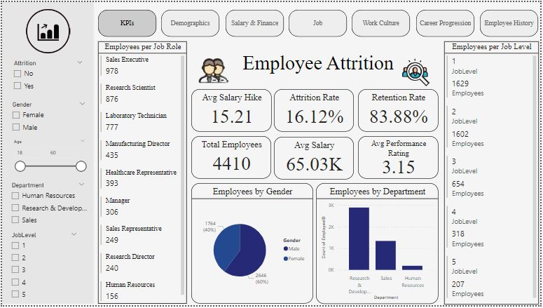
KPI 1

Slide 35
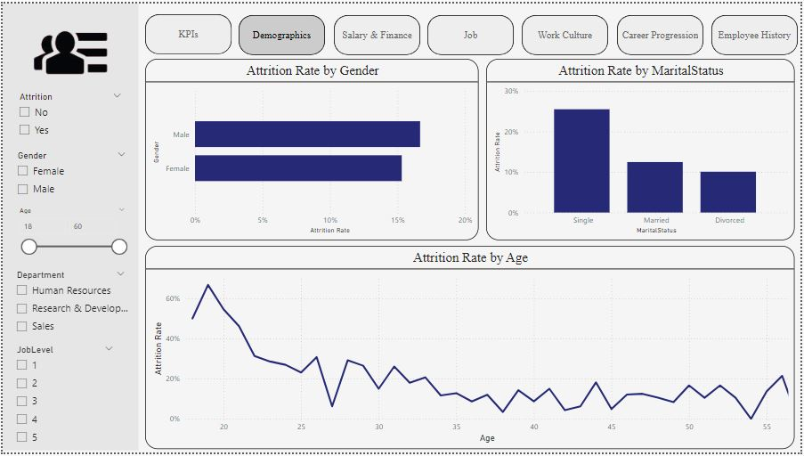
KPI 2

Slide 36
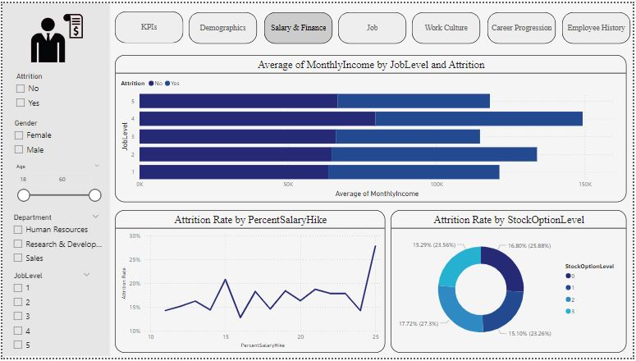
KPI 3

Slide 37
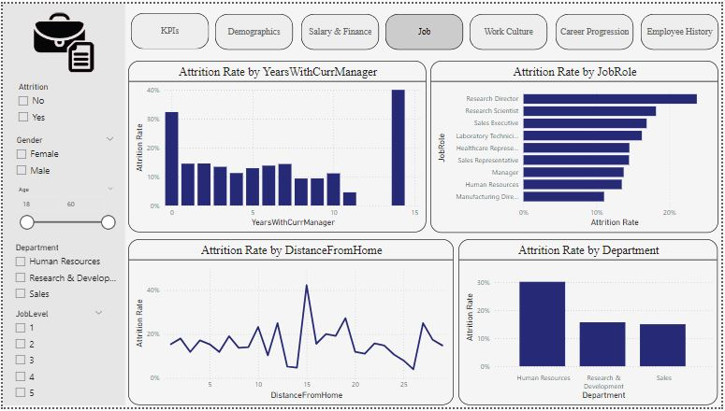
KPI 4

Slide 38
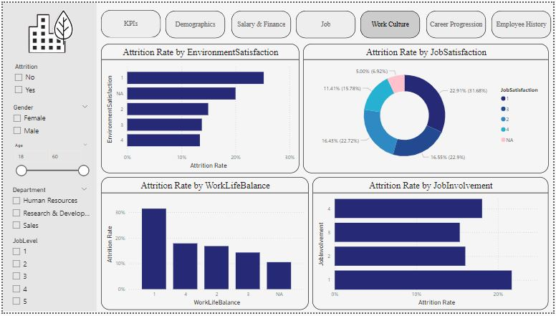
KPI 5

Slide 39
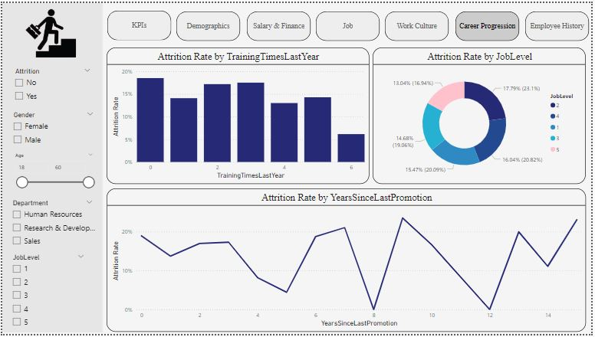
KPI 6

Slide 40
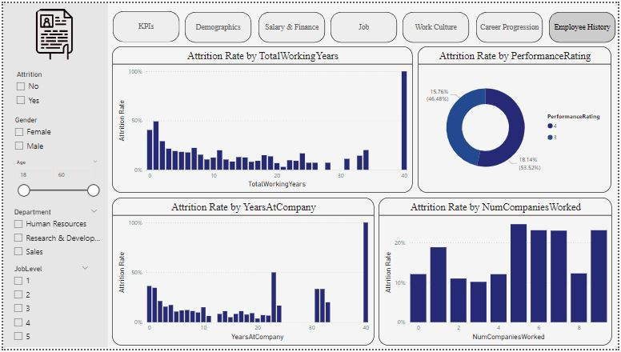
KPI 7

Slide 41
Insights
Here’s a comprehensive list of the insights derived from the analysis, providing a roadmap for informed decision-making and targeted strategies to enhance employee retention and foster a thriving work environment.
The company’s overall attrition rate stands at 16%, with an average monthly income of 65.03K.
The attrition rate among male employees was the highest at 63%.
Single employees experienced the highest attrition. Employees living nearby displayed the highest attrition rates.
The research and development department recorded the highest attrition rate among the three departments at 56%.
Laboratory technicians, sales executives, and research scientists held the job roles with the highest attrition rates.
Over time workers experienced a higher attrition rate.
Employees aged 31–45 had the highest attrition, while those aged 46–60 had the least turnover.

Slide 42
Recommendations
Targeted Retention Strategies: Given the higher attrition among male employees, single individuals, and those living nearby, consider implementing targeted retention strategies for these specific demographics. Explore initiatives that address their unique needs and preferences, aiming to improve overall satisfaction and commitment.
Career Development for Entry-Level Employees: As entry-level employees exhibit higher attrition rates, focus on enhancing career development programs and mentorship opportunities for this group. Providing a clear growth path can contribute to greater job satisfaction and loyalty.
Performance Improvement Programs: With employees holding low-performance ratings having the highest attrition, consider implementing performance improvement programs. Identify the root causes of underperformance and provide support, training, or resources to help employees meet expectations.
Departmental Engagement Initiatives: The research and development department experiences significant attrition. Explore targeted engagement initiatives within this department, such as professional development opportunities, team-building activities, and recognition programs to enhance employee satisfaction and retention.

Slide 43
Findings
From the PowerBI dashboard observations and jupyter notebook bar graphs we can observe the below Findings
Attrition Overview
Out of 4410 employees, 1764 have left the company, resulting in a 16.2% attrition rate. On average, employees were 37 years old and had worked for 7 years.
Age Group Analysis
Employees between the ages of 26-35 were observed to have the highest attrition rates, signaling potential challenges in retaining this demographic segment.
Educational Background Impact
Attrition was notably observed among employees with educational backgrounds in life sciences and medical fields, indicating potential areas for targeted retention initiatives.
Salary Influence
Employees earning less than 40k salary demonstrated a higher likelihood of attrition, emphasizing the importance of competitive compensation and benefits packages in retention efforts

Slide 44
Conclusion
In conclusion, we embarked on a comprehensive analysis of the HR Analytics Attrition Dataset, from data loading to model evaluation. By implementing and evaluating various machine learning algorithms, we gained insights into which models are effective for predicting employee attrition. The results and visualizations generated throughout the process provide valuable information for decision-makers and HR professionals seeking to understand and mitigate employee attrition within the organization. This project showcases the power of data analysis and machine learning in addressing real-world business challenges.

Slide 45
Thank you

